Slide 1
Regression-Based Classification
UIUC ECON 490: Applied Machine Learning in Economics

Slide 2
Classification and LPM
Quality vs. Quantity

Slide 3
Classification
Economic Examples
What major do students choose?
What products do consumers choose?
Homeownership
Labor force participant

Slide 4

Linear Probability Model (LPM)
$$y_{i}=\left\{\begin{matrix}1 & \text{weakly} \text{positive} \text{net} \text{job} \text{creation} \\ 0 & \text{not}\end{matrix}\right.$$
$$y_{i}=\underset{p\left(x_{i}\right)}{\underbrace{β_{0}+{x_{i}β}_{1}}}+ε_{i}$$
$$y_{i}=p(x_{i})+ε_{i}$$
$$p(x_{i})=Pr(y_{i}=1|x_{i})$$
Inference…

Slide 5
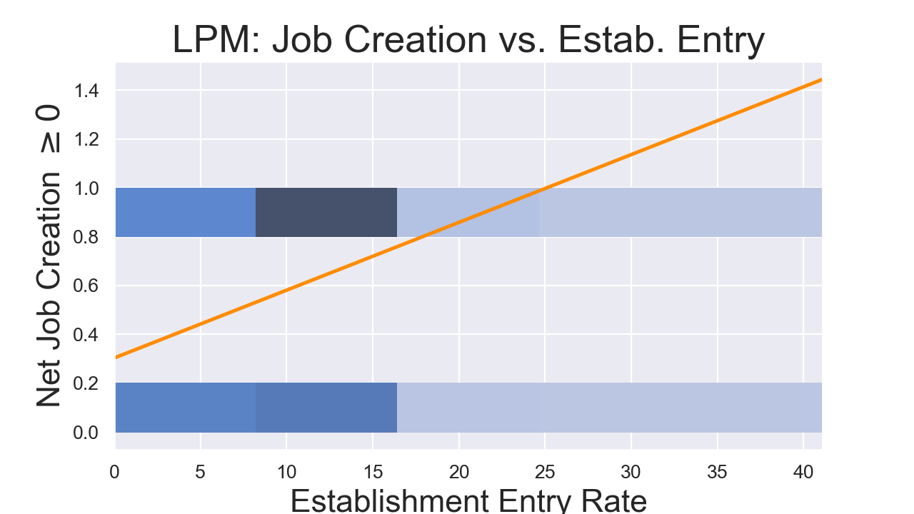
LPM Limitations

Slide 6
Binomial Logistic Regression
A sigmoid function

Slide 7
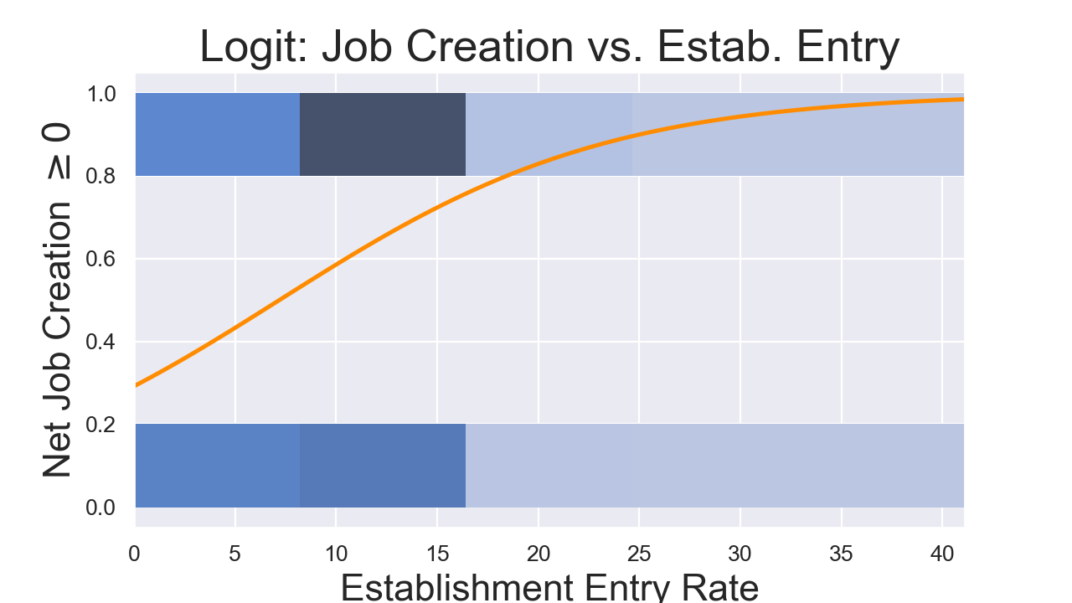
Sigmoid Shapes

Slide 8

Functional Form
LPM:
$$p\left(x_{i}\right)=β_{0}+{x_{i}β}_{1}$$
Logit:
$$p\left(x_{i}\right)=\frac{e^{β_{0}+{x_{i}β}_{1}}}{1+e^{β_{0}+{x_{i}β}_{1}}}$$
$$\frac{p\left(x_{i}\right)}{1−p\left(x_{i}\right)}=e^{β_{0}+{x_{i}β}_{1}}$$
$$log\left(\frac{p\left(x_{i}\right)}{1−p\left(x_{i}\right)}\right)=β_{0}+{x_{i}β}_{1}$$

Slide 9
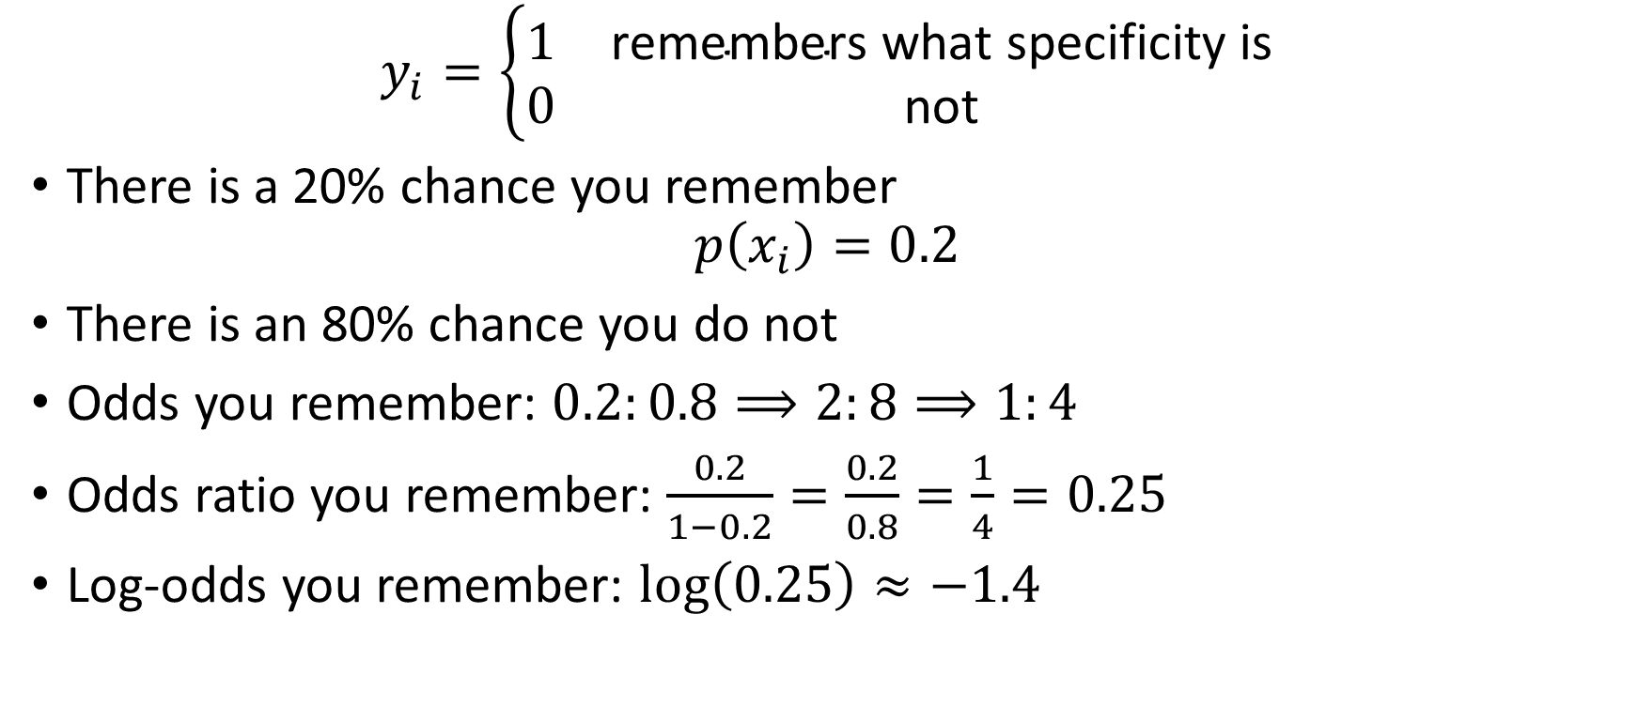
Log-odds
$$y_{i}=\left\{\begin{matrix}1 & \text{remember}\text{s} \text{what} \text{specificity} \text{is} \\ 0 & \text{no}\text{t}\end{matrix}\right.$$
There is a 20% chance you remember
$$p\left(x_{i}\right)=0.2$$
There is an 80% chance you do not
Odds you remember: $0.2:0.8⟹2:8⟹1:4$
Odds ratio you remember: $\frac{0.2}{1−0.2}=\frac{0.2}{0.8}=\frac{1}{4}=0.25$
Log-odds you remember: $\log\left(0.25\right)≈−1.4$

Slide 10
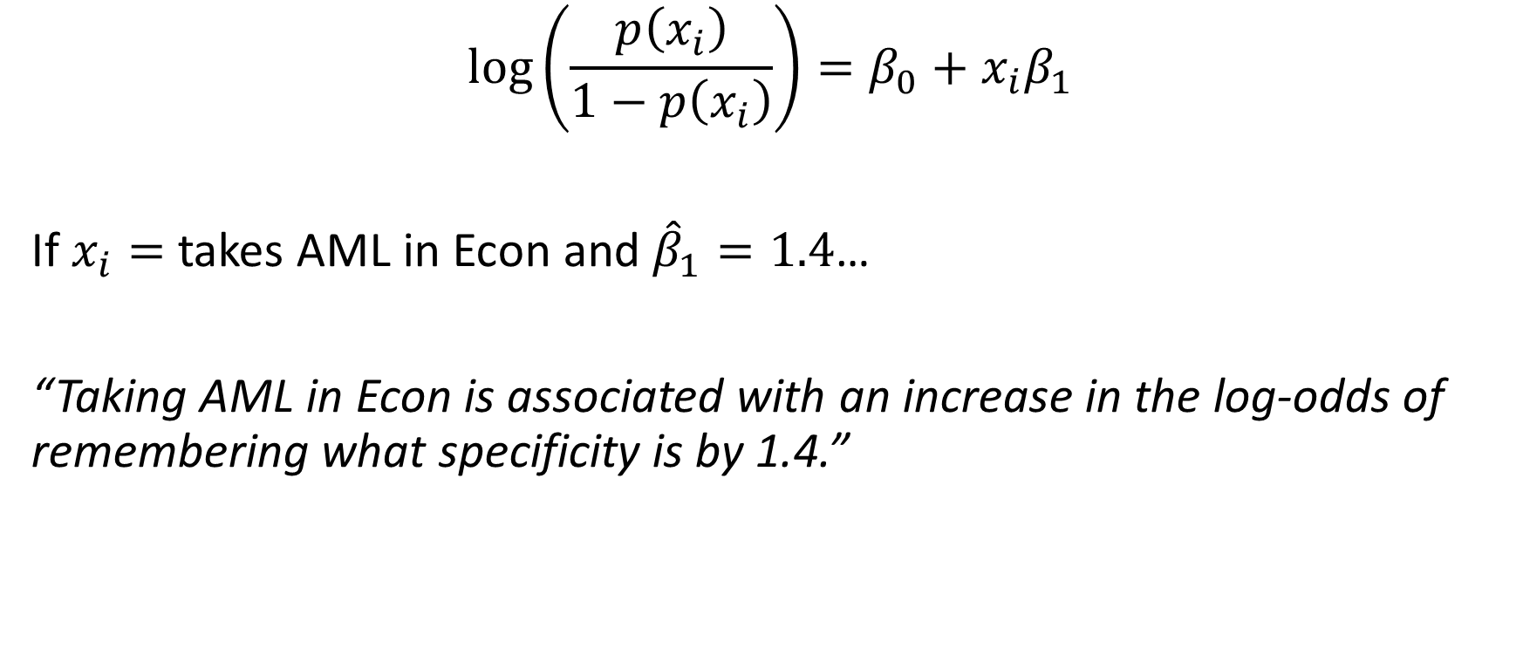
Interpretation
$$log\left(\frac{p\left(x_{i}\right)}{1−p\left(x_{i}\right)}\right)=β_{0}+{x_{i}β}_{1}$$
If $x_{i}=$ takes AML in Econ and ${\hat{β}}_{1}=1.4$…
“Taking AML in Econ is associated with an increase in the log-odds of remembering what specificity is by 1.4.”

Slide 11
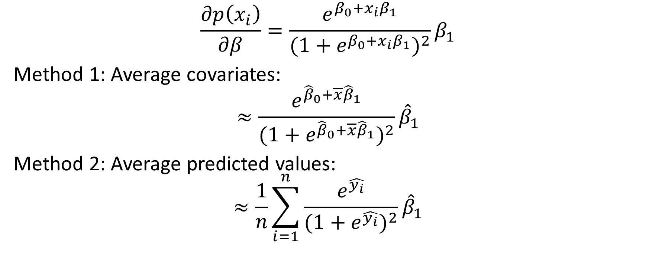
Marginal Effects
$$\frac{∂p\left(x_{i}\right)}{∂β}=\frac{e^{β_{0}+{x_{i}β}_{1}}}{(1+e^{β_{0}+{x_{i}β}_{1}})^{2}}β_{1}$$
Method 1: Average covariates:
$$≈\frac{e^{{\hat{β}}_{0}+\overline{x}{\hat{β}}_{1}}}{(1+e^{{\hat{β}}_{0}+\overline{x}{\hat{β}}_{1}})^{2}}{\hat{β}}_{1}$$
Method 2: Average predicted values:
$$≈\frac{1}{n}\sum_{i=1}^{n}{\frac{e^{\hat{y_{i}}}}{(1+e^{\hat{y_{i}}})^{2}}}{\hat{β}}_{1}$$

Slide 12
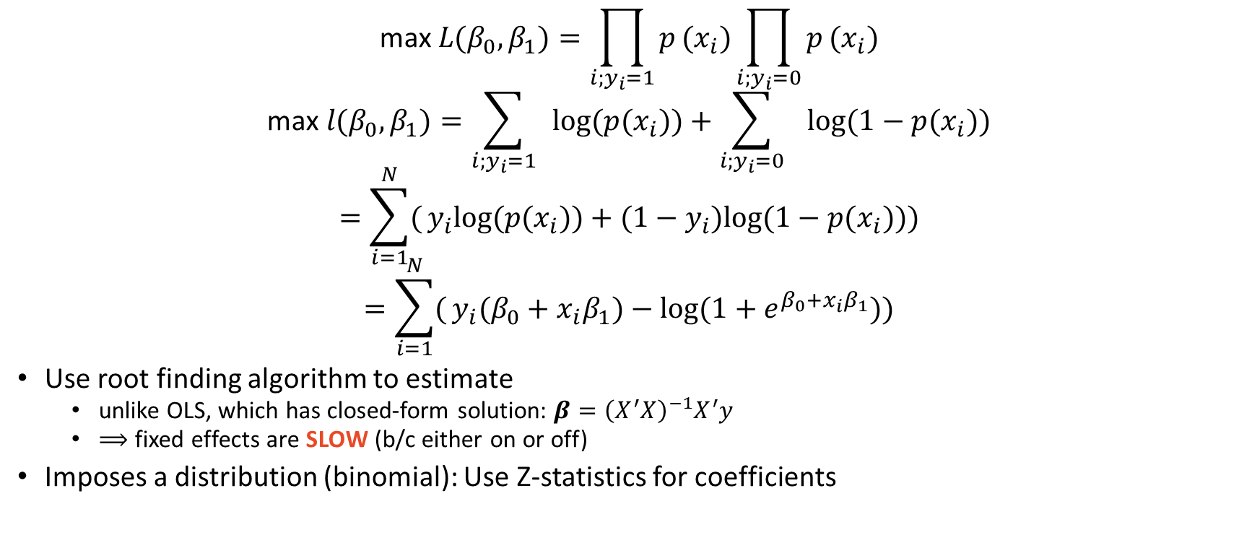
Estimation
$$\text{max} L(β_{0},β_{1})=\prod_{i;y_{i}=1}^{​}{p}(x_{i})\prod_{i;y_{i}=0}^{​}{p}(x_{i})$$
$$\text{max} l(β_{0},β_{1})=\sum_{i;y_{i}=1}^{​}{ }log(p(x_{i}))+\sum_{i;y_{i}=0}^{​}{ }log(1−p(x_{i}))$$
$$=\sum_{i=1}^{N}{(}y_{i}log(p(x_{i}))+(1−y_{i})log(1−p(x_{i})))$$
$$=\sum_{i=1}^{N}{(}y_{i}(β_{0}+{x_{i}β}_{1})−log(1+e^{β_{0}+{x_{i}β}_{1}}))$$
Use root finding algorithm to estimate
unlike OLS, which has closed-form solution: $β={\left(X^{′}X\right)}^{−1}X^{′}y$
$⟹$ fixed effects are SLOW (b/c either on or off)
Imposes a distribution (binomial): Use Z-statistics for coefficients

Slide 13
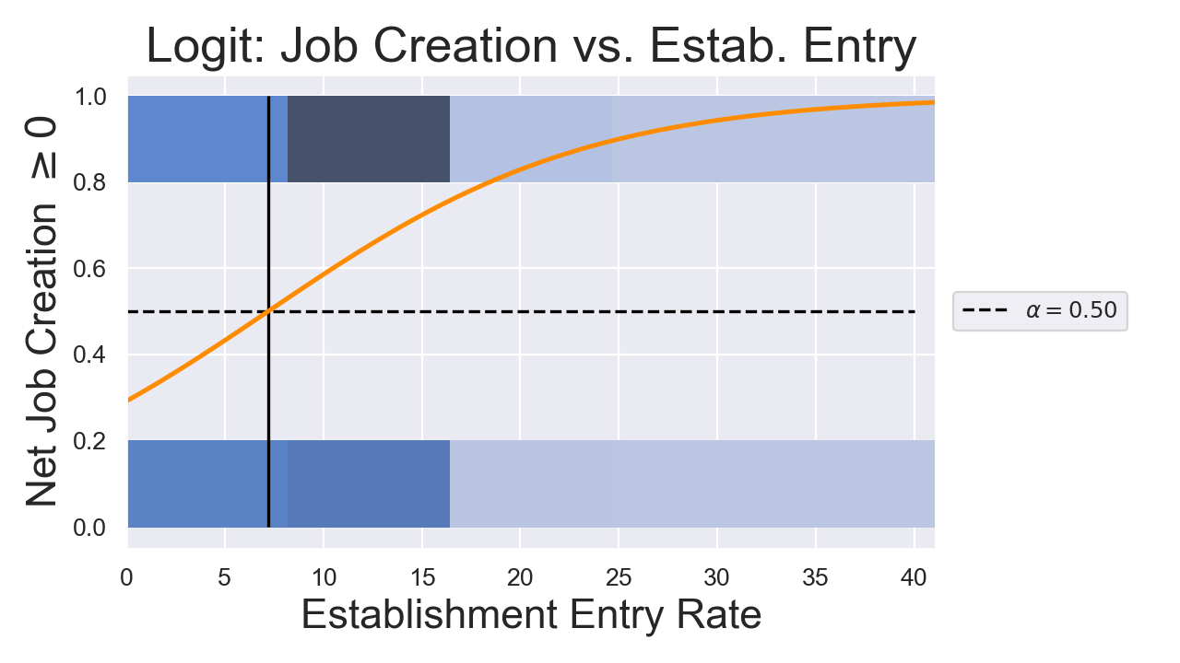
A Note On Logit Classifying: Thresholds

Slide 14
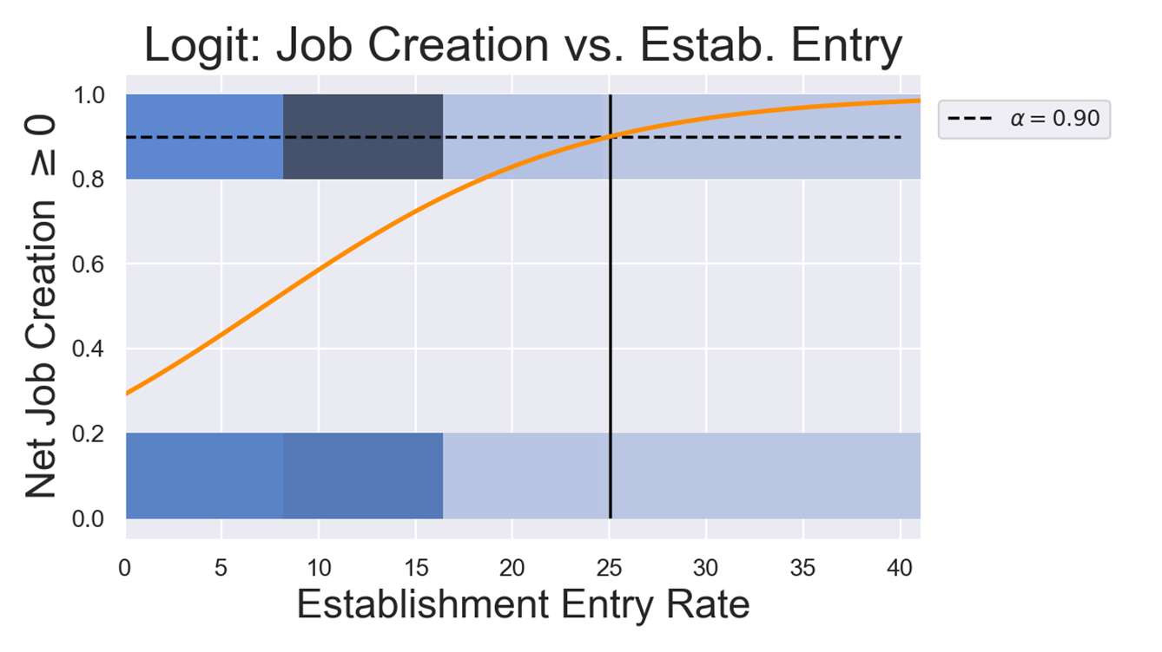
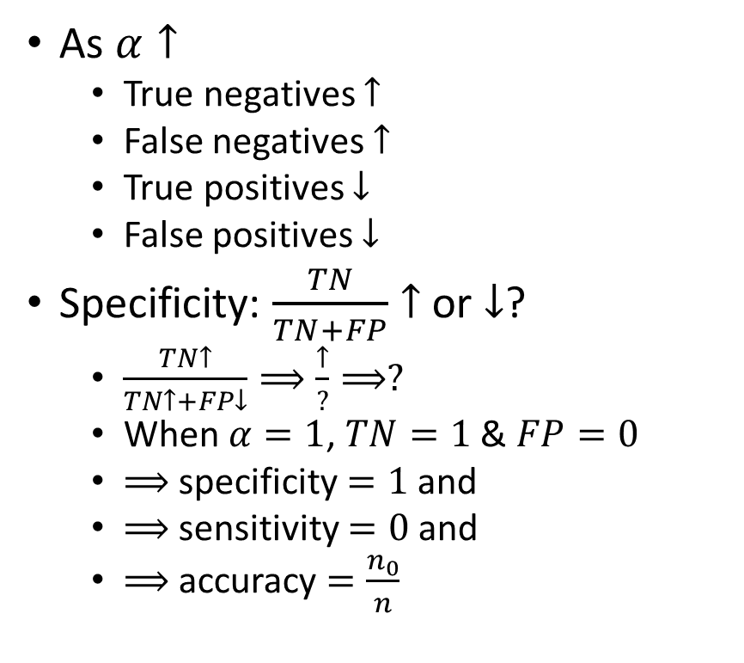
Increase Threshold
As $α↑$
True negatives $↑$
False negatives $↑$
True positives $↓$
False positives $↓$
Specificity: $\frac{TN}{TN+FP}$ $↑$ or $↓$?
$\frac{TN↑}{TN↑+FP↓}⟹\frac{↑}{?}⟹?$
When $α=1$, $TN=1$ & $FP=0$
$⟹$ specificity $=1$ and
$⟹$ sensitivity $=0$ and
$⟹$ accuracy $=\frac{n_{0}}{n}$

Slide 15
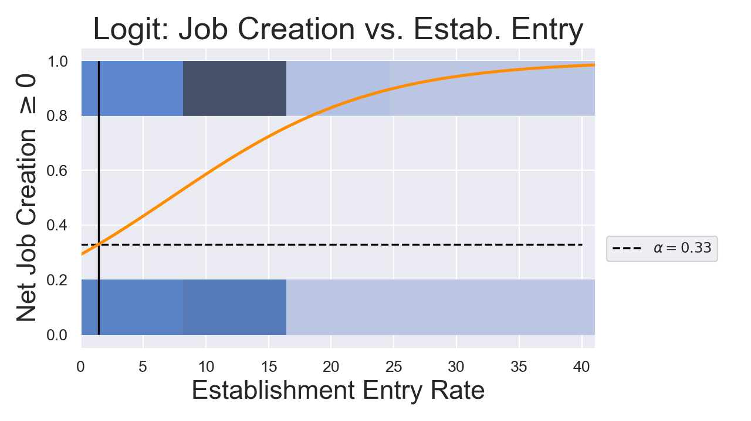
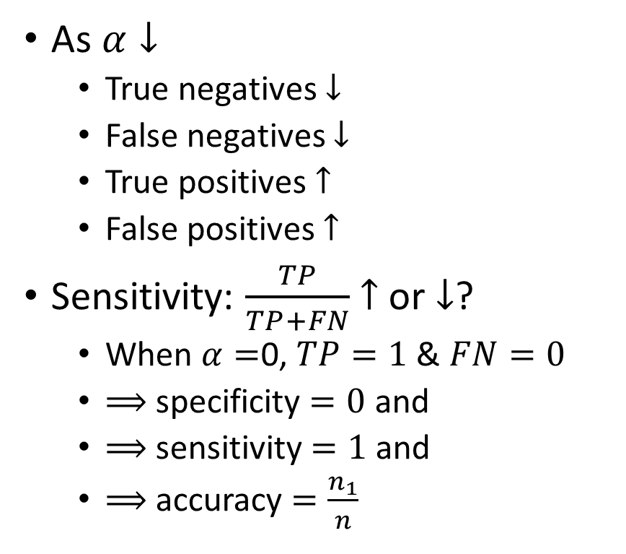
Decrease Threshold
As $α↓$
True negatives $↓$
False negatives $↓$
True positives $↑$
False positives $↑$
Sensitivity: $\frac{TP}{TP+FN}$ $↑$ or $↓$?
When $α=$0, $TP=1$ & $FN=0$
$⟹$ specificity $=0$ and
$⟹$ sensitivity $=1$ and
$⟹$ accuracy $=\frac{n_{1}}{n}$

Slide 16
Question
Is the logit threshold a hyperparameter?

Slide 17
Answer
YES!!!!

Slide 18
Multinomial Logistic Regression
More Classes

Slide 19

LPM Limitations Part 2
$$Y=\left\{\begin{matrix}1 & \text{apples} \\ 2 & \text{toothpaste} \\ 3 & \text{charcoal}\end{matrix}\right.$$
Uh… what do I do with these extra classes?

Slide 20
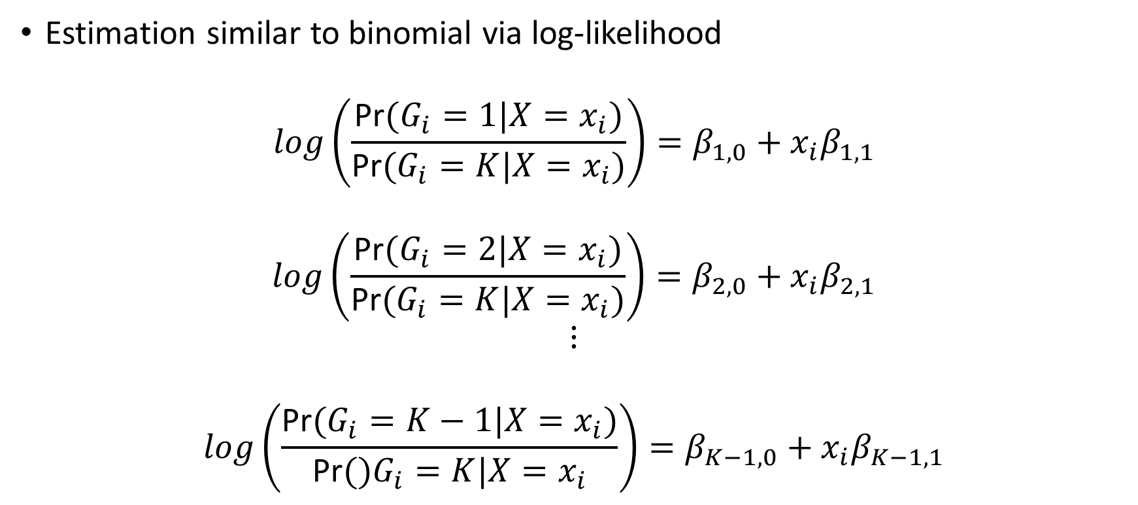
Multinomial Logistic Regression
Estimation similar to binomial via log-likelihood
$$log\left(\frac{\text{Pr}(G_{i}=1|X=x_{i})}{\text{Pr}(G_{i}=K|X=x_{i})}\right)=β_{1,0}+x_{i}β_{1,1}$$
$$log\left(\frac{\text{Pr}(G_{i}=2|X=x_{i})}{\text{Pr}(G_{i}=K|X=x_{i})}\right)=β_{2,0}+x_{i}β_{2,1}$$
$$⋮$$
$$log\left(\frac{\text{Pr}(G_{i}=K−1|X=x_{i})}{\text{Pr}()G_{i}=K|X=x_{i}}\right)=β_{K−1,0}+x_{i}β_{K−1,1}$$

Slide 21

Multinomial Logistic Regression
$$\text{Pr}(G_{i}=k|X=x_{i})=\frac{e^{β_{k,0}+x_{i}β_{k,1}}}{1+\sum_{l=1}^{K−1}{e^{β_{l,0}+x_{i}β_{l,1}}}}$$
for $k=1,...,K−1$
$$\text{Pr}(G_{i}=K|X=x_{i})=\frac{1}{1+\sum_{l=1}^{K−1}{e^{β_{l,0}+x_{i}β_{l,1}}}}$$

Slide 22
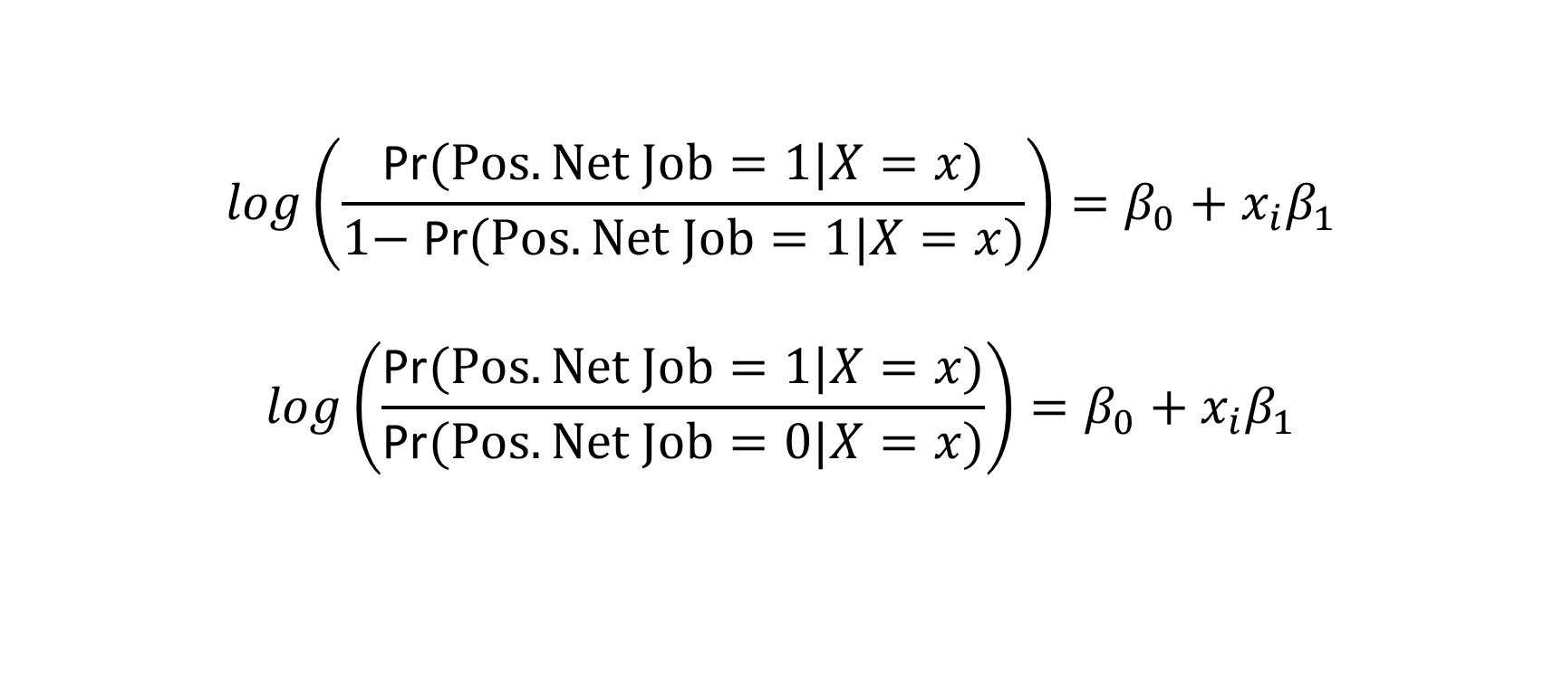
Comparison to Binomial
$$log\left(\frac{\text{Pr}(Pos. Net Job=1|X=x)}{\text{1}\text{− }\text{Pr}(Pos. Net Job=1|X=x)}\right)=β_{0}+{x_{i}β}_{1}$$
$$log\left(\frac{\text{Pr}(Pos. Net Job=1|X=x)}{\text{Pr}(Pos. Net Job=0|X=x)}\right)=β_{0}+{x_{i}β}_{1}$$

Slide 23

Inference
If $K=$ toothpaste, $k=$ apples, $β_{k,1}=2$, and $x_{i}=log(wage)$
A one percent increase in wages is associated with an increase in the log odds of apples relative to toothpaste by 2.

